Slide 1
Data Mining and Machine Learning for Business
DSCI 5240

Slide 2
Linear Regression
Machine Learning
Supervised Learning
Regression
Linear regression
A simple yet important supervised learning model
Many complex models are extensions of linear regression model

Slide 3
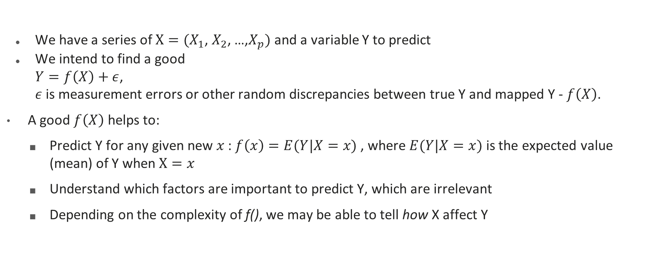
The Mathematical Mapping between Y and Xs
We have a series of $X=(X_{1}$, $X_{2}$, …,$X_{p})$ and a variable Y to predict
We intend to find a good
$Y=f\left(X\right)+ε$,
$ε$ is measurement errors or other random discrepancies between true Y and mapped Y - $f\left(X\right)$.
A good $f\left(X\right)$ helps to:
Predict Y for any given new $x$: $f\left(x\right)=E(Y|X=x)$ , where $E(Y|X=x)$ is the expected value (mean) of Y when $X=x$
Understand which factors are important to predict Y, which are irrelevant
Depending on the complexity of f(), we may be able to tell how X affect Y

Slide 4
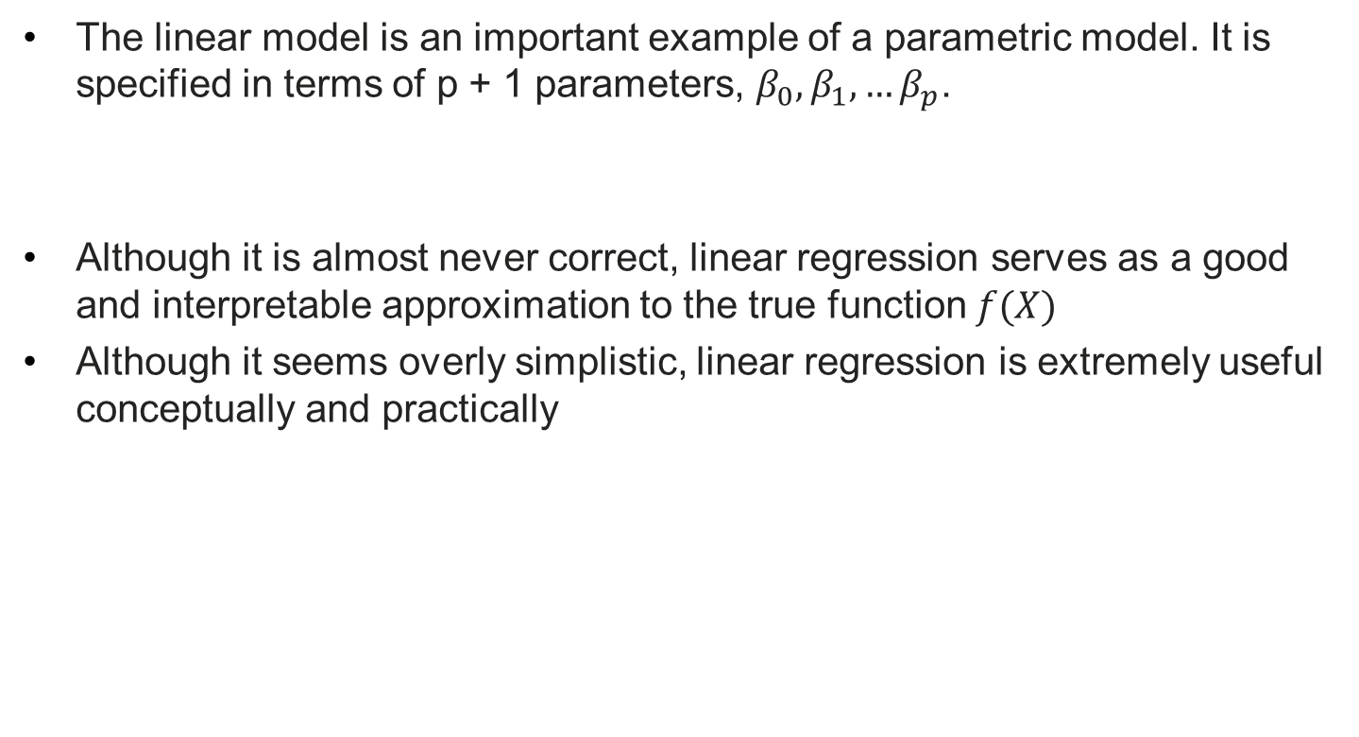
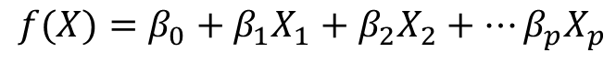
A simple $f\left(X\right)$ - Linear model
The linear model is an important example of a parametric model. It is specified in terms of p + 1 parameters, $β_{0},β_{1}, …β_{p}$.
Although it is almost never correct, linear regression serves as a good and interpretable approximation to the true function $f(X)$
Although it seems overly simplistic, linear regression is extremely useful conceptually and practically
$$f(X)=β_{0}+β_{1}X_{1}+β_{2}X_{2}+…β_{p}X_{p}$$

Slide 5
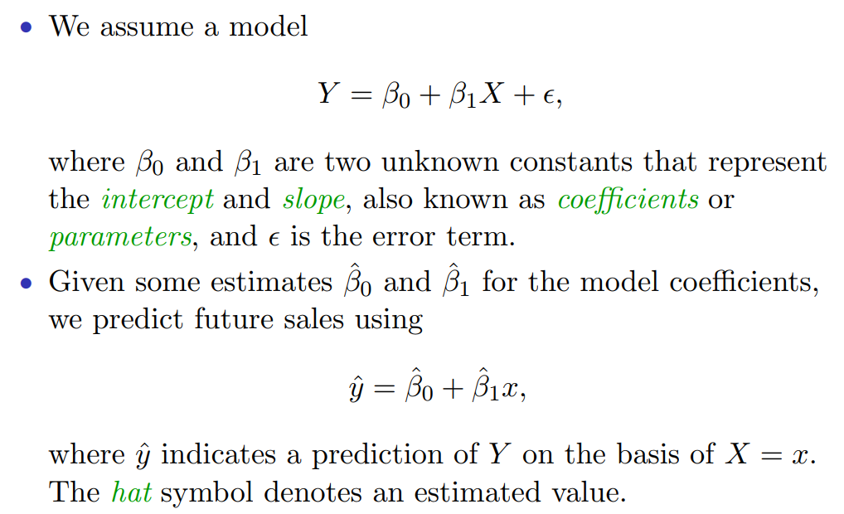
With one predictor X

Slide 6
An Example
TV | radio | newspaper | sales
230.1 | 37.8 | 69.2 | 22.1
44.5 | 39.3 | 45.1 | 10.4
17.2 | 45.9 | 69.3 | 9.3
151.5 | 41.3 | 58.5 | 18.5
180.8 | 10.8 | 58.4 | 12.9
8.7 | 48.9 | 75 | 7.2
57.5 | 32.8 | 23.5 | 11.8
120.2 | 19.6 | 11.6 | 13.2
8.6 | 2.1 | 1 | 4.8
199.8 | 2.6 | 21.2 | 10.6
66.1 | 5.8 | 24.2 | 8.6
214.7 | 24 | 4 | 17.4
23.8 | 35.1 | 65.9 | 9.2
97.5 | 7.6 | 7.2 | 9.7
204.1 | 32.9 | 46 | 19
195.4 | 47.7 | 52.9 | 22.4
67.8 | 36.6 | 114 | 12.5
281.4 | 39.6 | 55.8 | 24.4
69.2 | 20.5 | 18.3 | 11.3
147.3 | 23.9 | 19.1 | 14.6
218.4 | 27.7 | 53.4 | 18
237.4 | 5.1 | 23.5 | 12.5
13.2 | 15.9 | 49.6 | 5.6
228.3 | 16.9 | 26.2 | 15.5
62.3 | 12.6 | 18.3 | 9.7
262.9 | 3.5 | 19.5 | 12
142.9 | 29.3 | 12.6 | 15
240.1 | 16.7 | 22.9 | 15.9
248.8 | 27.1 | 22.9 | 18.9
70.6 | 16 | 40.8 | 10.5
292.9 | 28.3 | 43.2 | 21.4
Problem: Can we predict sales based on advertising spendings?
Data: the sales of a product in 200 different markets, along with advertising budgets for the product in each of those markets for three different media: TV, radio, and newspaper.
Model: Linear model

Slide 7
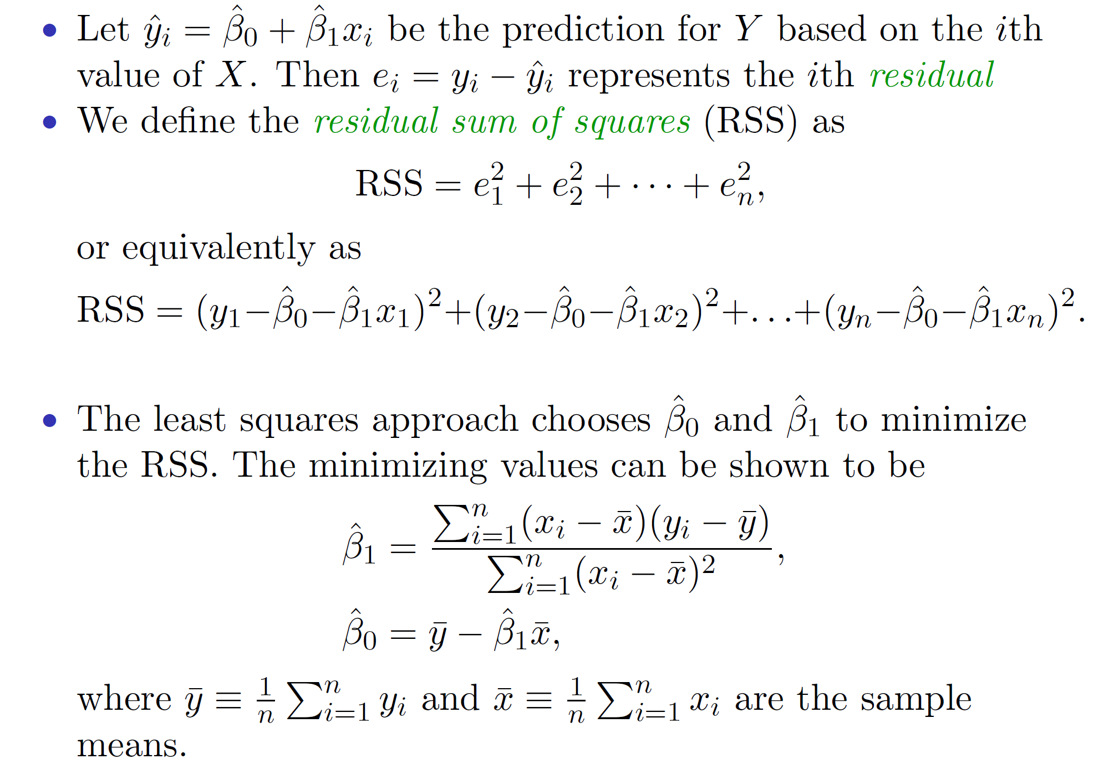
How to find parameter values? – Least squares
The error / residual: the difference between true y and predicted y
Minimize the sum of error squares by choosing betas

Slide 8
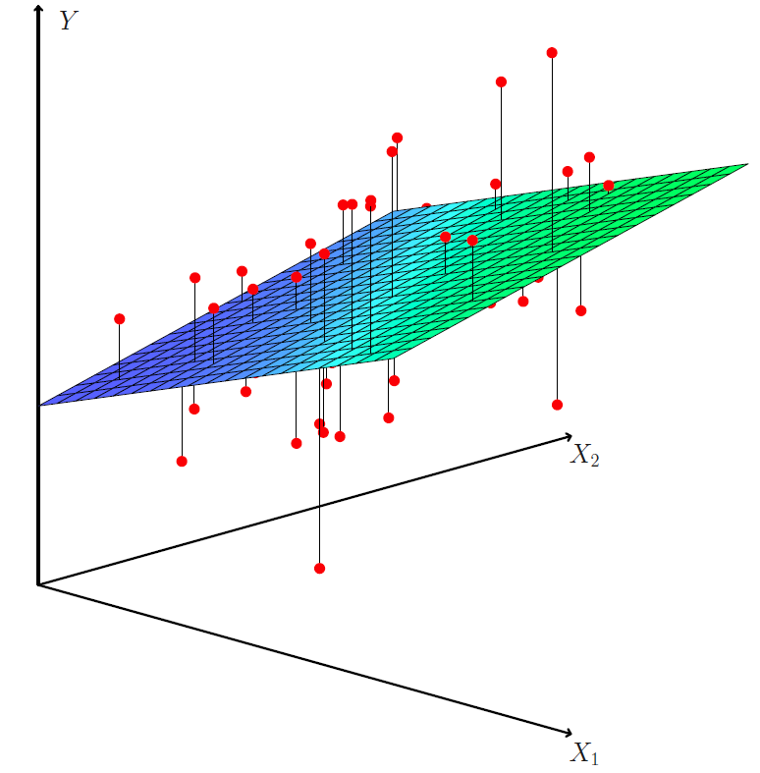
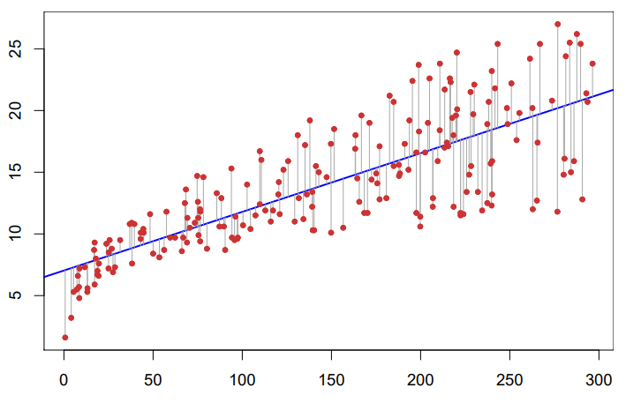
As shown in the graph
Minimize the sum of squared errors (vertical distances between each observation, as shown in red, and the line).
Minimize the sum of squared errors (vertical distances between each observation, as shown in red, and the plane).

Slide 9
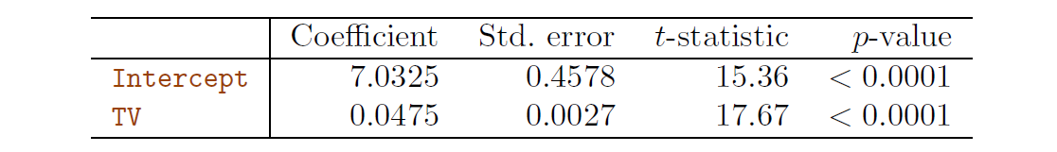
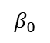
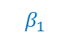
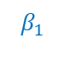
The output for a single variable
$$β_{0}$$
$$β_{1}$$
The coefficient of TV advertising: An increase of 1 unit in the TV advertising budget is associated with an increase in sales by 0.0475 units.
The estimated standard deviation of the slope: Roughly, there is a 95% chance that the true slope lies within 2 standard deviations, i.e., between 0.0421 and 0.0526
The probability of observing such t-statistic given to be 0
$$β_{1}$$
TV advertising: 1 unit = 1000 dollars;
Sales: 1 unit = 1000

Slide 10
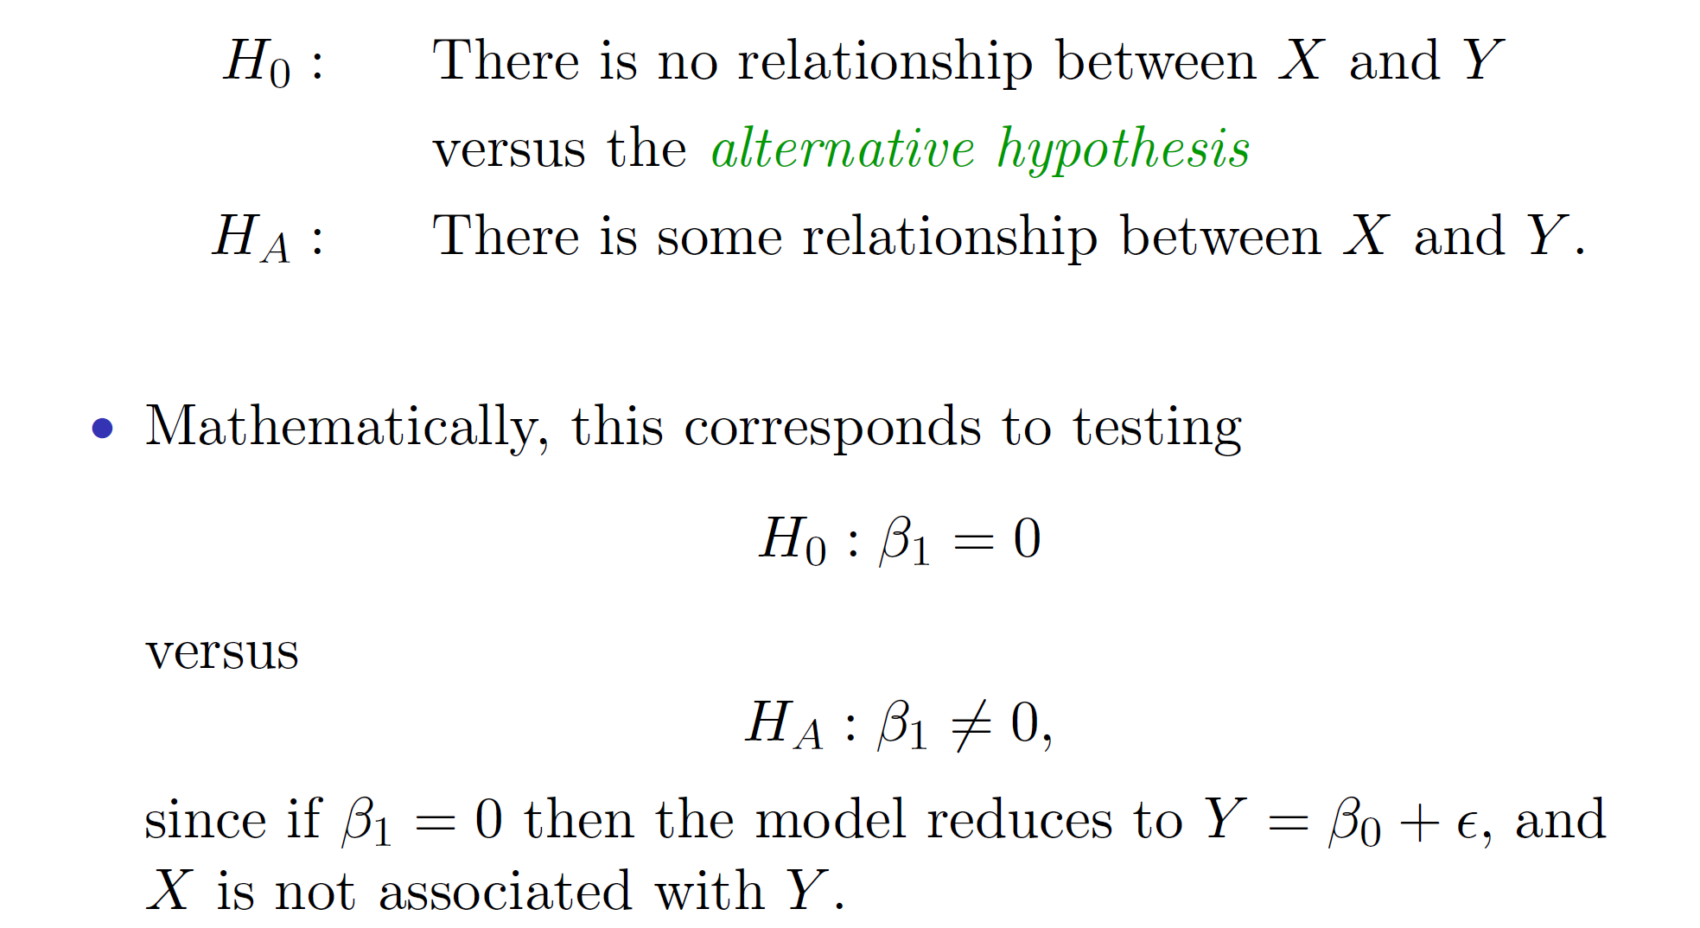
Q1. Which factors are important in predicting Y?
The outcome of the test exhibits in p-values: if p-value is less than 5%, we are confident to reject the null hypothesis.
That means, the alternative hypothesis is correct.
Given H₀
Calculate T-statistic
P-value: whether to reject H₀
There is / isn’t a relationship between X and Y

Slide 11
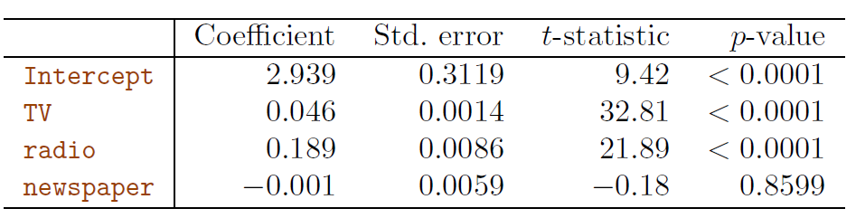
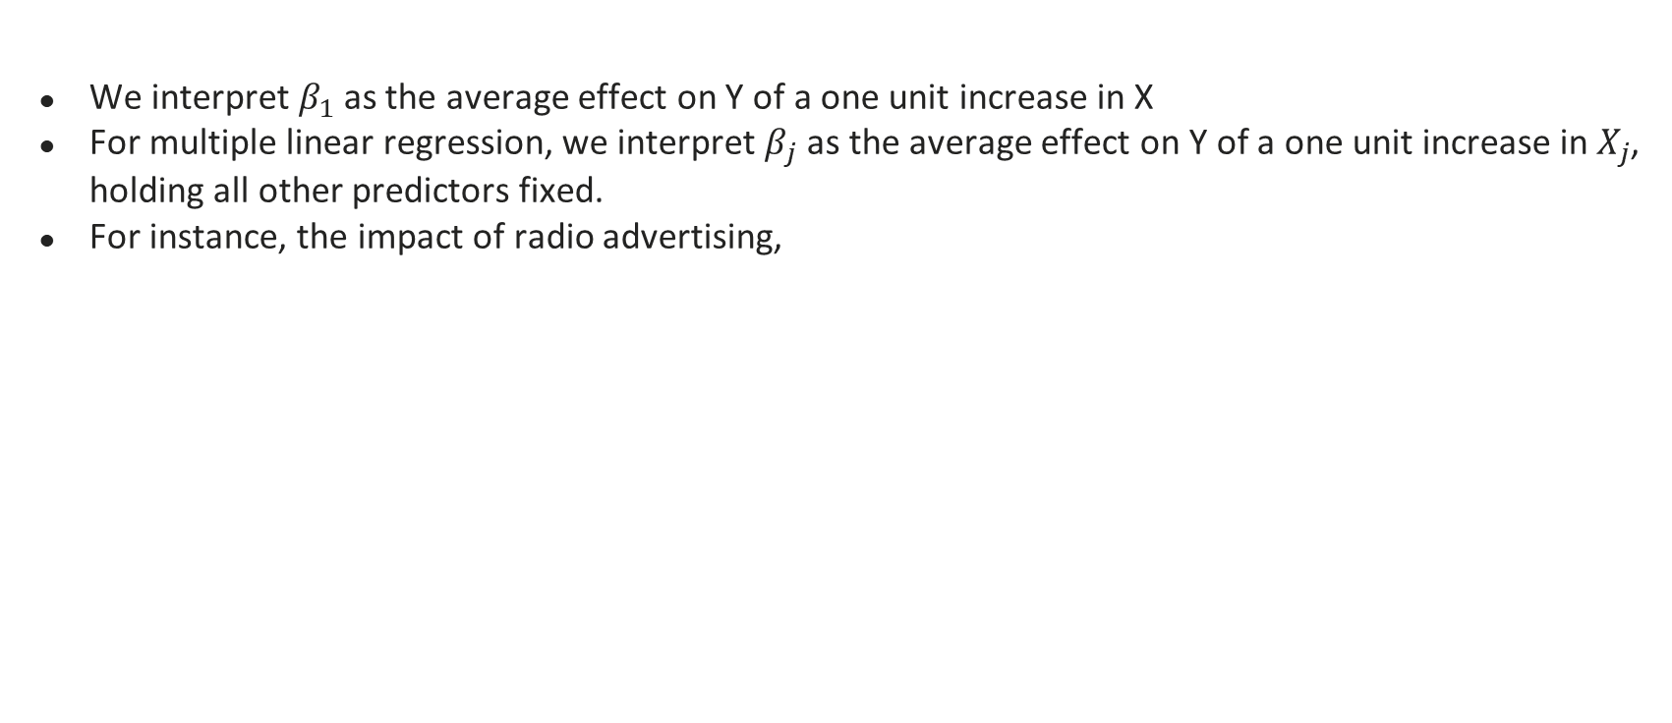
Q2. How does each factor affect Y?
We interpret $β_{1}$ as the average effect on Y of a one unit increase in X
For multiple linear regression, we interpret $β_{j}$ as the average effect on Y of a one unit increase in $X_{j}$, holding all other predictors fixed.
For instance, the impact of radio advertising,
For a given amount of TV and newspaper advertising, spending an additional $1,000 on
radio advertising is associated with approximately 189 units of additional sales.

Slide 12
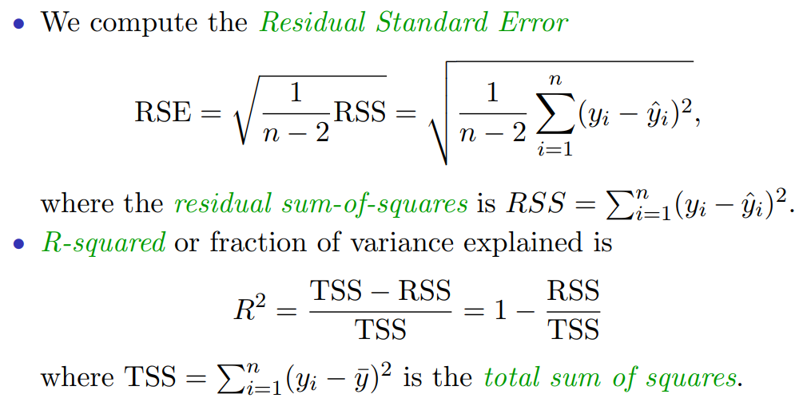
Q3. How well does the model fit the data?
R-squared (R²) measures the proportion of variability in Y that can be explained using X
The larger, the better

Slide 13
Comparisons of R²
Model | R² | RSE
TV | 0.61 | 3.26
TV + Radio | 0.89719 | 1.681
TV + Radio + Newspaper | 0.8972 | 1.686
Newspaper provides no real improvement in model fit but increases RSE (residual standard error).
R² is always larger with more variables
Adjusted R² takes that into consideration and should be a better indicator for variable selection.
So, the best model is TV + Radio

Slide 14
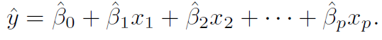
Q4. How to make predictions of Y?
It is straightforward to predict Y using the estimated coefficients and the model
For example, TV = 44.5, radio = 39.3, newspaper = 45.1:
Estimated sales: 2.939 + 0.046*44.5 + 0.189 * 39.3 + (-0.001) * 45.1 = 12.37
Observed sales: 10.4
Errors could come from
The estimated coefficients have errors
The linear model only approximately captures the relationship between Xs and Y
Even with a perfect model, there are random errors we cannot control

Slide 15
Intervals to quantify the uncertainty
For given values of Xs, we can estimate two types of Y values:
E.g., $100,000 TV, $20 radio
Confidence interval (95%)
Estimated average Y value over many markets
[10,985, 11,528]
95% of such intervals will contain the true value
Prediction interval (95%)
Estimated Y value for a single market
[7,930, 14,580]
95% of such intervals will contain the true value
As prediction interval is more restricted, the interval is always wider than the confidence interval
Reflecting the uncertainty is larger for predicting sales of a single market than the average of many markets

Slide 16
Other considerations
Improve the model

Slide 17
1. Qualitative variables
Examples
Ownership (own/not own a house)
Education levels (High school, undergraduate, graduate, professional)
Product categories (Food, Electronics, Appliances, etc.)
…
Solution:
Dummy variables: indicators we generate based on the values of the qualitative variable

Slide 18
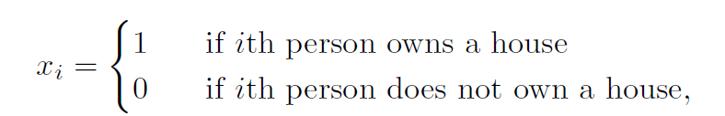
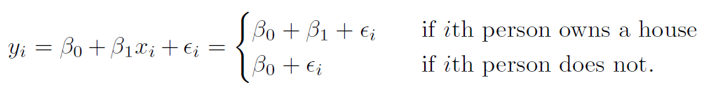
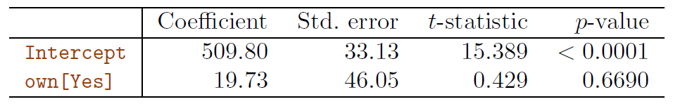
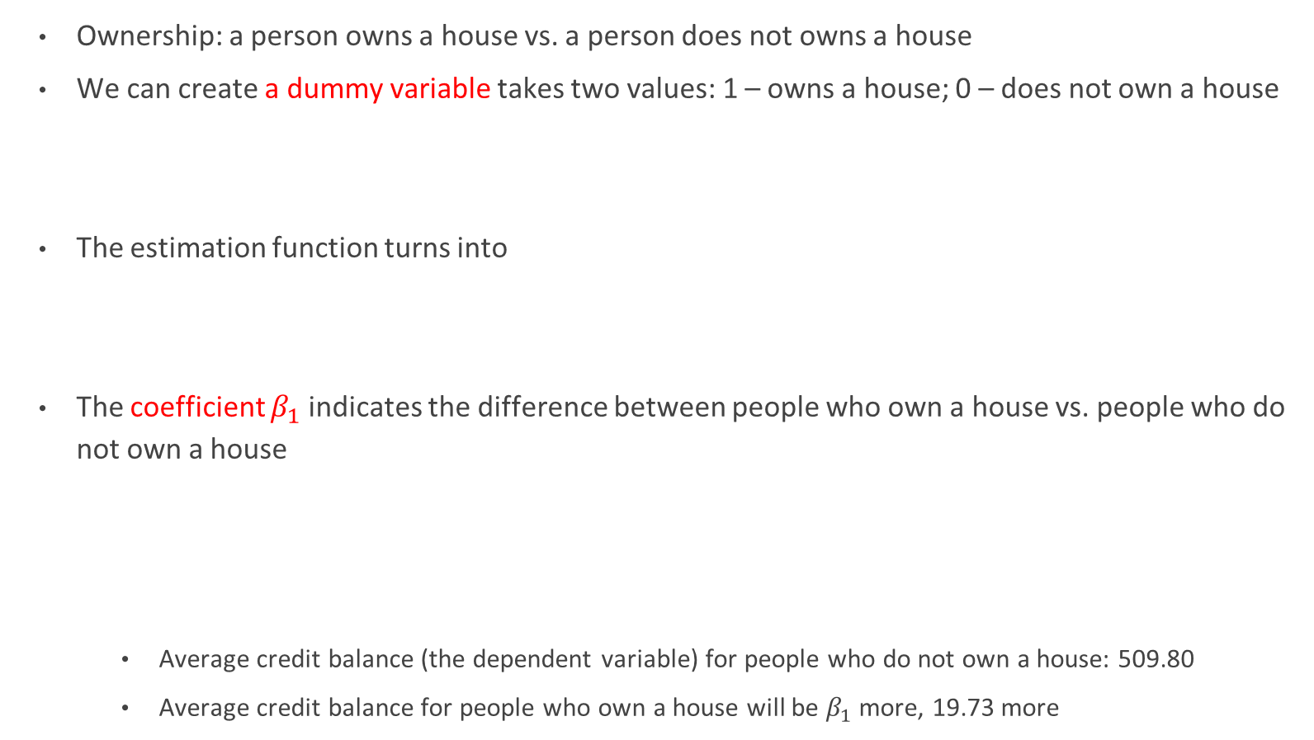
A qualitative variable with two levels
Ownership: a person owns a house vs. a person does not owns a house
We can create a dummy variable takes two values: 1 – owns a house; 0 – does not own a house
The estimation function turns into
The coefficient $β_{1}$ indicates the difference between people who own a house vs. people who do not own a house
Average credit balance (the dependent variable) for people who do not own a house: 509.80
Average credit balance for people who own a house will be $β_{1}$ more, 19.73 more

Slide 19
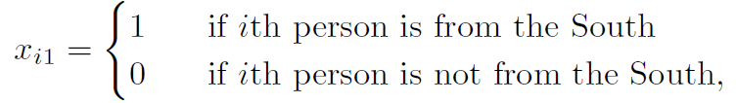
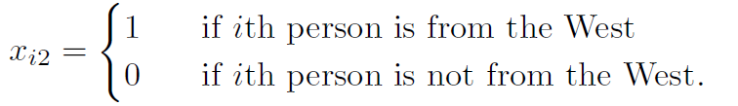
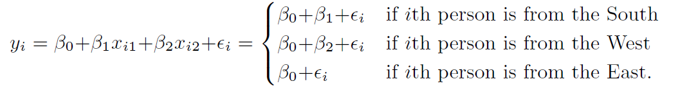
A qualitative variable with more than levels
We can create additional dummy variables
For example, variable ‘region’ has three levels: East, West and South
We can create the following dummy variables
There will always be one dummy variable fewer than the number of levels (n – 1). The level with no dummy variable - East in this example - is known as the baseline.
The level selected as the baseline category is arbitrary, and the final predictions for each group will be the same regardless of this choice.
The estimation function will be

Slide 20
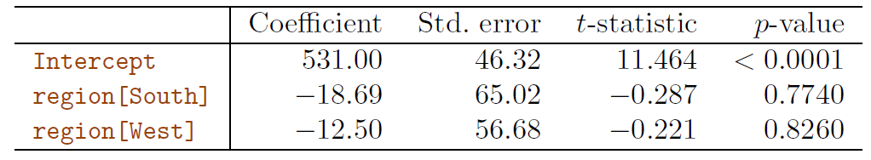
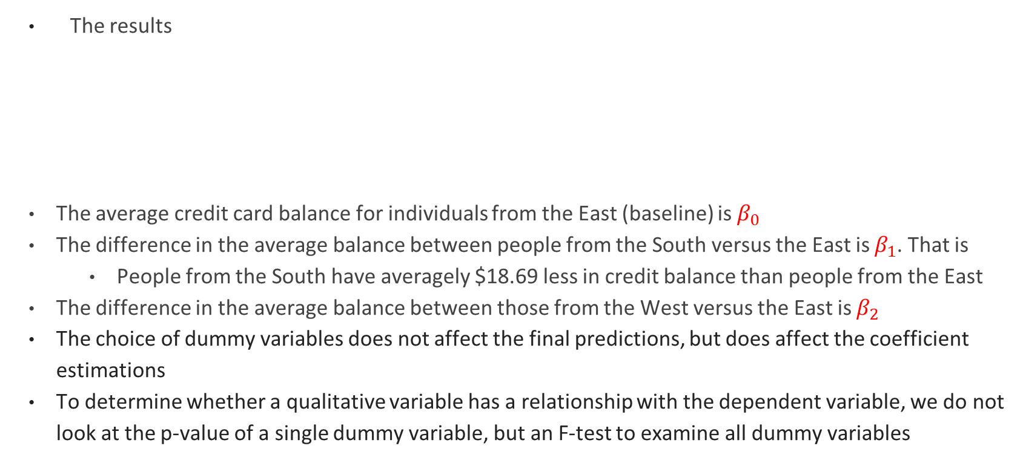
More than two levels - Continued
The results
The average credit card balance for individuals from the East (baseline) is $β_{0}$
The difference in the average balance between people from the South versus the East is $β_{1}$. That is
People from the South have averagely $18.69 less in credit balance than people from the East
The difference in the average balance between those from the West versus the East is $β_{2}$
The choice of dummy variables does not affect the final predictions, but does affect the coefficient estimations
To determine whether a qualitative variable has a relationship with the dependent variable, we do not look at the p-value of a single dummy variable, but an F-test to examine all dummy variables

Slide 21
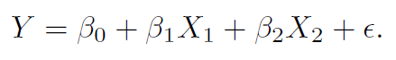
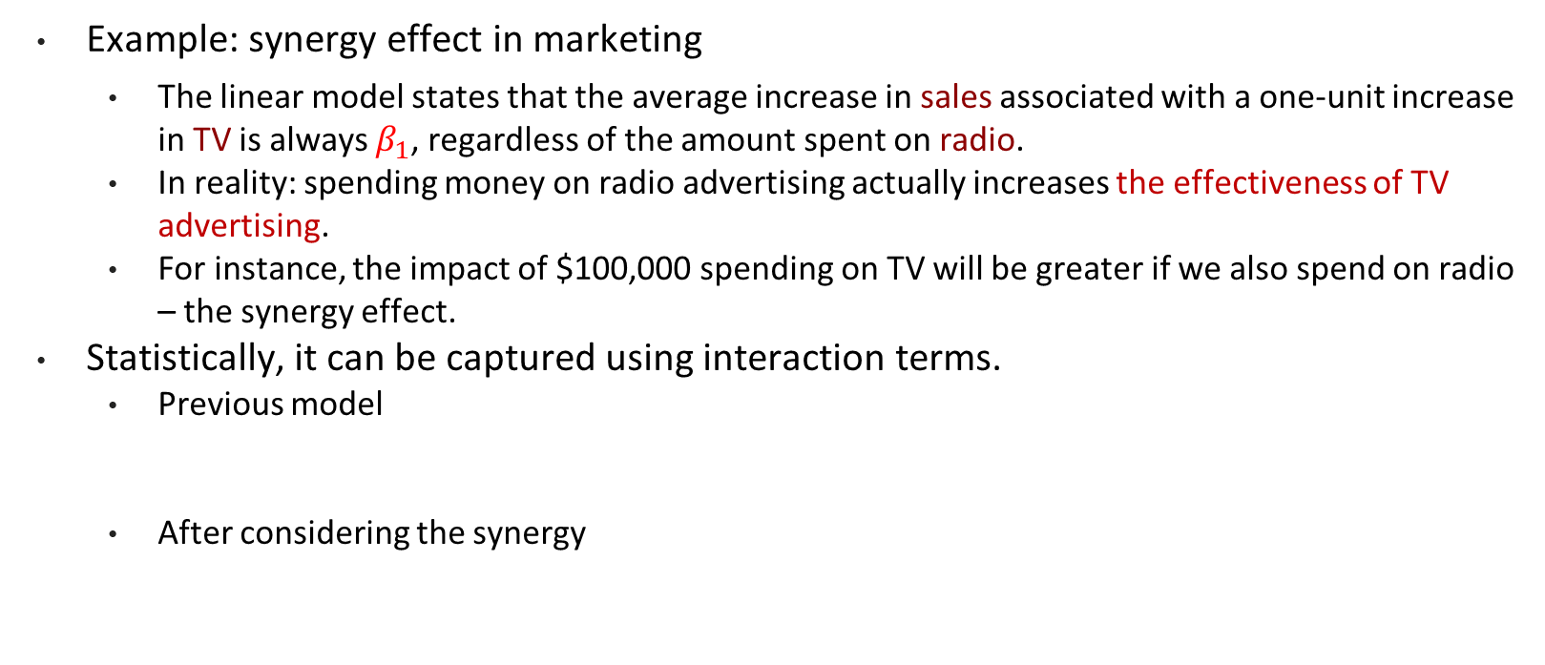
2. Interaction
Example: synergy effect in marketing
The linear model states that the average increase in sales associated with a one-unit increase in TV is always $β_{1}$, regardless of the amount spent on radio.
In reality: spending money on radio advertising actually increases the effectiveness of TV advertising.
For instance, the impact of $100,000 spending on TV will be greater if we also spend on radio – the synergy effect.
Statistically, it can be captured using interaction terms.
Previous model
After considering the synergy
Interaction term

Slide 22
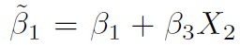
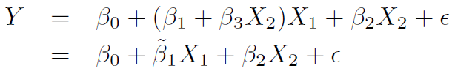
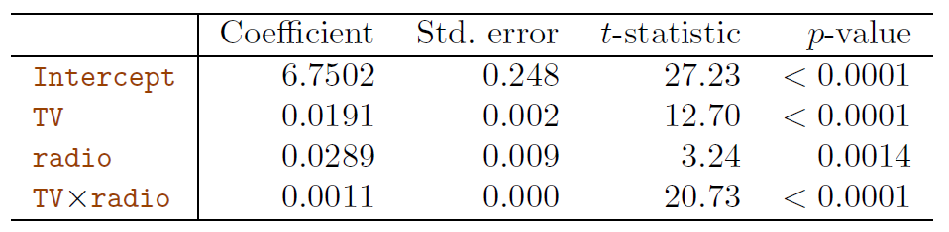
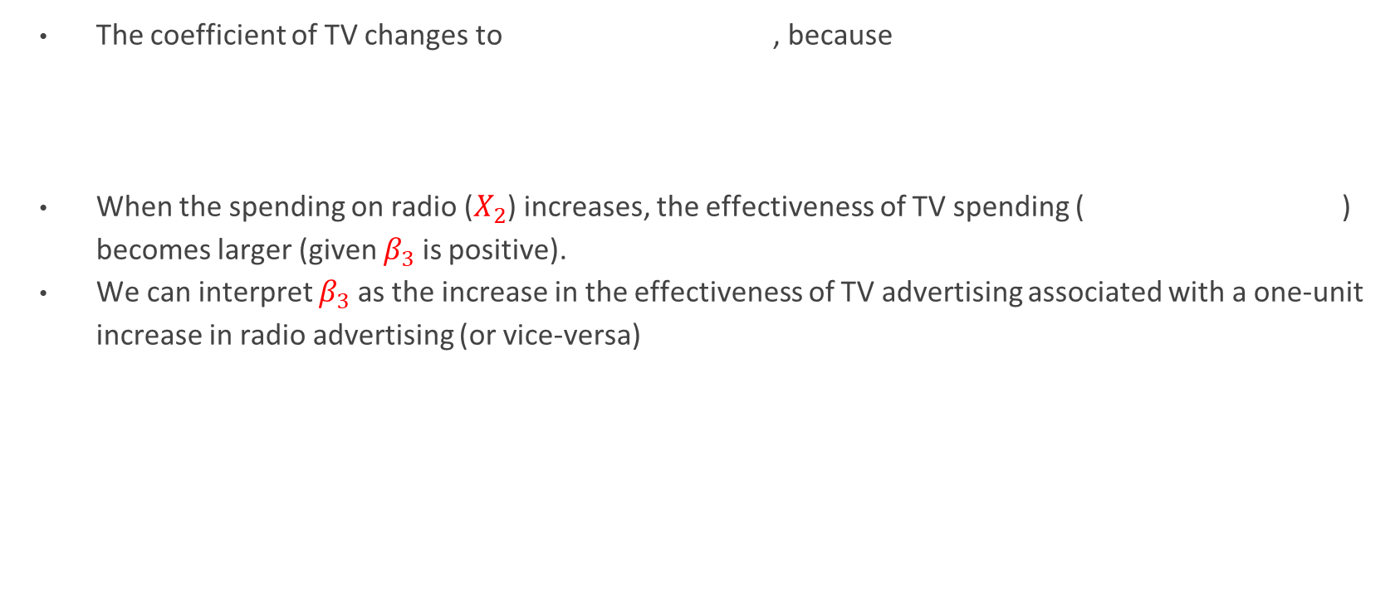
Interaction - continued
The coefficient of TV changes to , because
When the spending on radio ($X_{2}$) increases, the effectiveness of TV spending ( ) becomes larger (given $β_{3}$ is positive).
We can interpret $β_{3}$ as the increase in the effectiveness of TV advertising associated with a one-unit increase in radio advertising (or vice-versa)
The R² for this model is 96.8 %, compared to only 89.7% for the model that predicts sales using TV and radio without an interaction term.

Slide 23
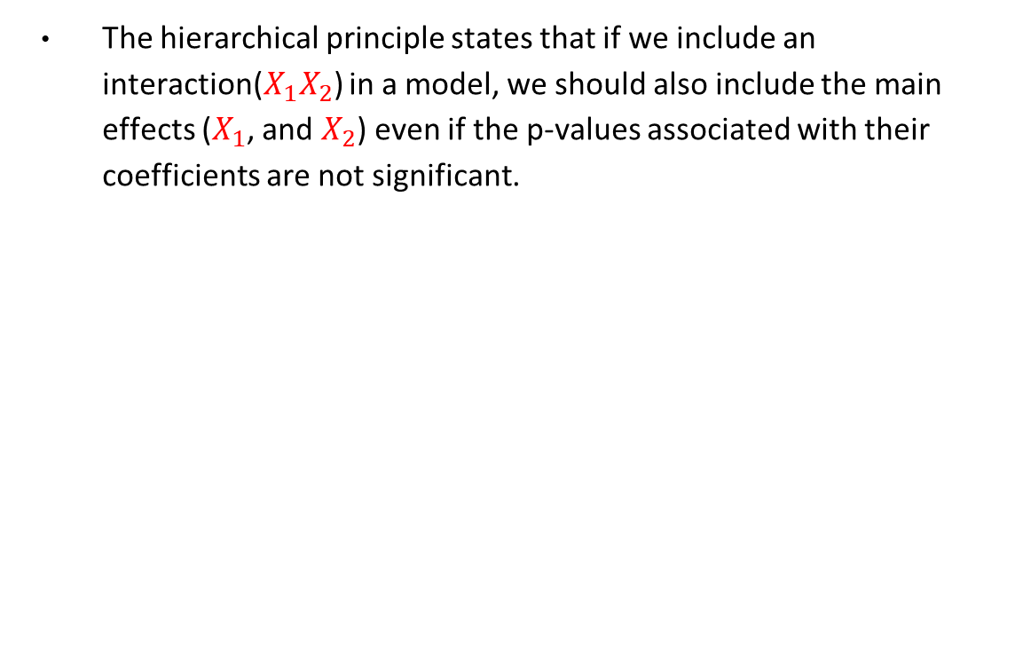
Interaction – Hierarchy principle
The hierarchical principle states that if we include an interaction(${X_{1}X}_{2}$) in a model, we should also include the main effects ($X_{1}$, and $X_{2}$) even if the p-values associated with their coefficients are not significant.

Slide 24
Further considerations
Non-linear relationships: further discussion in Chapter 7
Correlation of error terms: often happens in time-series data
Non-constant variance of error terms: heteroscedasticity
Weighted least squares when we know it fits certain pattern
Outliers: Y takes unusual values
High-leverage points: Xs take unusual values
Collinearity: variables are highly correlated with each other
Drop one of the problematic variables
Combine variables: Principal Component Analysis could be used

Slide 25
Takeaways
Linear regression model specifications
Key questions about the results
Which factors are more important predicting Y?
How does each factor affect Y?
How well does the model fit the data?
How to make predictions of Y?
Improve the model
Qualitative variables
Interaction

